Slide 1

A Project on "Smart Online Academic Project Management System with AI-Driven Supervision and Real-Time Collaboration"
Under Guidance of Prof.
Manisha P. Navale
NBN Sinhgad School of Engineering
2025-2026 Sem VIII

Slide 2
Group Members
Abhijeet Indrjeet Bhosle
Aniket Vijay Chandan
Pratham Prashant Dhakate
Rajendra Narendra Patil
NBN Sinhgad School of Engineering
2025-2026 Sem VIII
Group 20

Slide 3
Index
INTRODUCTION
MOTIVATION
LITERATURE SURVEY
SYSTEM ARCHITECTURE
METHODOLOGY
REQUIREMENTS
KEY FEATURES
IMPLEMENTATION AND RESULTS
ADVANTAGES AND DISADVANTAGES
APPLICATION
CONCLUSION
REFERENCES

Slide 4
INTRODUCTION
Academic projects help students apply technical knowledge and develop practical skills.
Traditional project management methods rely on manual processes, causing delays and communication gaps.
Efficient project tracking, guide allocation, and collaboration are major challenges.
SOAPMS provides a centralized platform for managing the complete project lifecycle.
The system includes AI-based topic similarity checking, automated guide allocation, progress tracking, and real-time notifications.

Slide 5
MOTIVATION
Students struggle with finding unique topics and managing their work effectively.
Manual guide allocation and plagiarism checking increase faculty workload.
Lack of centralized monitoring for project progress and evaluations.
Communication gaps lead to delays in feedback and approvals.
Need for an intelligent platform with AI-based validation, automated allocation, and real-time tracking.

Slide 6
Literature Survey
Title | Authors & Year | Methodology
A Web-based Innovation and Entrepreneurship Project Management System Design for College Students | J. Wang (2024) | Proposed a web-based system focusing on digital management and user-centric design for student innovation and entrepreneurship projects.
Analysis of Multi-Objective Integrated Management System of Engineering Project Based on Ant Colony Algorithm. | R. Qi, Y. Qi, H. Tang (2023) | Applied Ant Colony Optimization for optimizing multiple objectives in engineering project management, improving decision-making and resource allocation.

Slide 7
Literature Survey
Title | Authors & Year | Methodology
Academic Project Information Management System | V. Arumugam, M. Shankar, A. B. Aslam (2021) | Developed a centralized system for managing academic project data, including assignment tracking, progress updates, and student-project mapping
Online Project Evaluation and Supervision System (oPENs) | S. I. Ismail, S. N. Sulaiman, N. N. Ismail (2017) | Presented an online platform for continuous evaluation and supervision of student academic projects with emphasis on remote monitoring.

Slide 8
Literature Survey
Title | Authors & Year | Methodology
Research and Application of Visual Engineering Project Management and Control System Based on Multimodal Information | Feng Wang, Ji Wang, Hao Cai, Gang Yang (2024) | Introduces a visual, multimodal information-driven project control system for engineering management to enhance tracking and visualization.
Structural Analysis in the Methodology of Building an IT Project Model | Liubava Chernova, Serhii Chernov, Iryna Zhuravel, Lyudmila Chernova, Anatoliy Zubarev, Kateryna Kolesnikova(2024) | Discusses methodological structural analysis to build robust IT project models using formal and systematic approaches

Slide 9
Literature Survey
Title | Authors & Year | Methodology
Approval System Development in Information System for Project Management in a Retail Company | A. A. Santoso, M. Y. S A. Winata, M. L. A. Cahyadi, I. R. Murmanto (2024) | Explains the development of an approval workflow integrated into a retail project management system, improving efficiency and traceability
Development of an Intelligent System for Predictive Analysis of Student Academic Performance using Machine Learning Techniques | A. Tripathi, K. T. V. Reddy (2025) | Focuses on using ML algorithms to predict student performance metrics, enabling proactive academic intervention and planning.

Slide 10
Literature Survey
Title | Authors & Year | Methodology
Enhancing Academic Project Management with Project Allocation and Management System (PAMS) | R. Reshmi et al., 2025 | Developed a web-based PAMS with role-based access for students, guides, and coordinators. Implemented project allocation, progress tracking, NLP-based project similarity detection, and centralized project management.

Slide 11
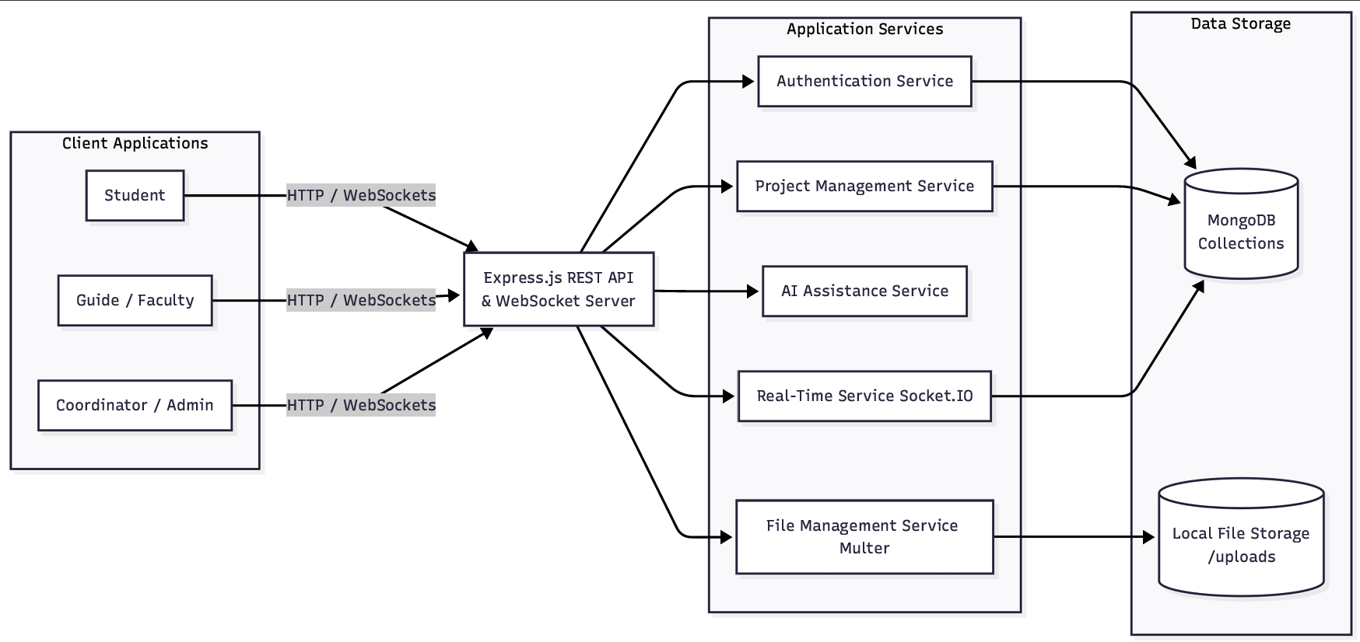
System Architecture
Three-Tier Architecture Model:
Client Tier (Frontend) – React.js SPA, Tailwind CSS for responsive layouts, Socket.IO-client for real-time channels.
Application Tier (Backend) – Node.js & Express.js server, JWT-based security middleware, and Socket.IO server.
Database Tier (Storage) – MongoDB (NoSQL) database storing user schemas, group details, evaluations, and logs.
AI/NLP Services Layer – TF-IDF Vectorizer & Cosine Similarity module for proposal topic similarity check.
Real-Time Message Engine – WebSockets (Socket.IO) facilitating instant alerts between coordinators, guides, and students.

Slide 12
Methodology
Requirement Gathering – Identify stakeholders, functional and non-functional needs.
System Design – Create architecture, ER diagrams, workflows, and role-based dashboards.
Technology Selection – Choose frontend, backend, database, AI modules, and real-time tools.
Implementation – Develop proposal submission, group formation, weekly reports, evaluations, and dashboards.
AI Integration – Incorporate plagiarism checks, topic clash detection, auto-feedback, and alerts.
Testing & Validation – Conduct unit, integration, performance, and security testing.
Deployment & Maintenance – Deploy on cloud/institutional server, set up backups, monitoring, and future enhancements.

Slide 13
Requirements
Software:
Operating System: Windows 10 or later / macOS / Linux
Web Browser: Google Chrome, Mozilla Firefox, or Microsoft Edge
Database: MongoDB
Development Tools: VS Code, Node.js, Git
Hardware:
Processor: Dual-core CPU or higher
RAM: 4 GB or higher
Storage: 50 GB free space
Internet: Broadband connection (for real-time collaboration and notifications)

Slide 14
Key Features
Secure Authentication – JWT-based login with role-based access.
Group Management – Create, join, and manage student project groups.
Project Proposal Submission – Submit and track project proposals online.
AI-Based Topic Similarity Check – Detect similar project topics to reduce duplication.
Automatic Guide Allocation – Assign guides based on expertise and workload.
Evaluation & Feedback – Guides can evaluate projects and provide feedback.
Real-Time Notifications – Instant updates using Socket.IO .
Coordinator Dashboard – Monitor projects, guides, and overall progress.

Slide 15
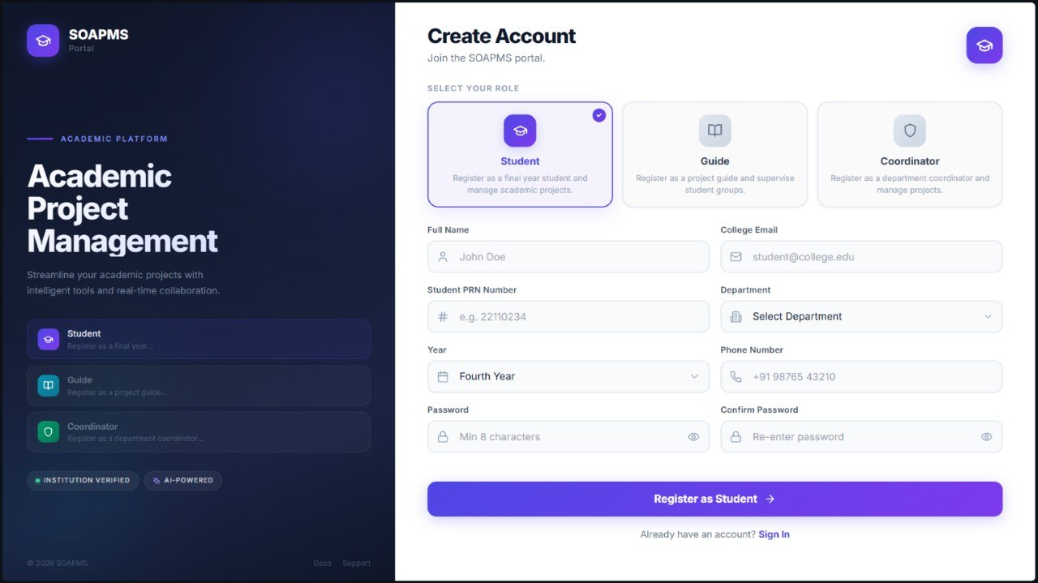
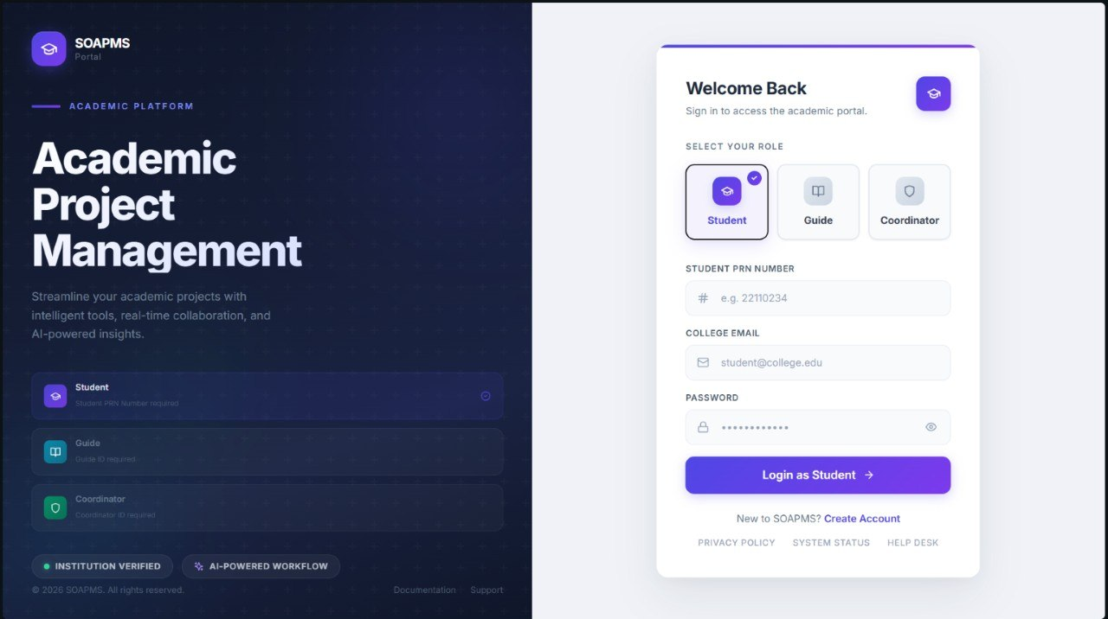
IMPLEMENTATION AND RESULTS
Implementation
Developed using MERN Stack (MongoDB, Express.js, React.js, Node.js)
Implemented secure JWT Authentication
Role-based dashboards for Students, Guides, and Coordinators
Integrated Socket.IO for real-time notifications
AI-based Topic Similarity Check for proposal validation

Slide 16
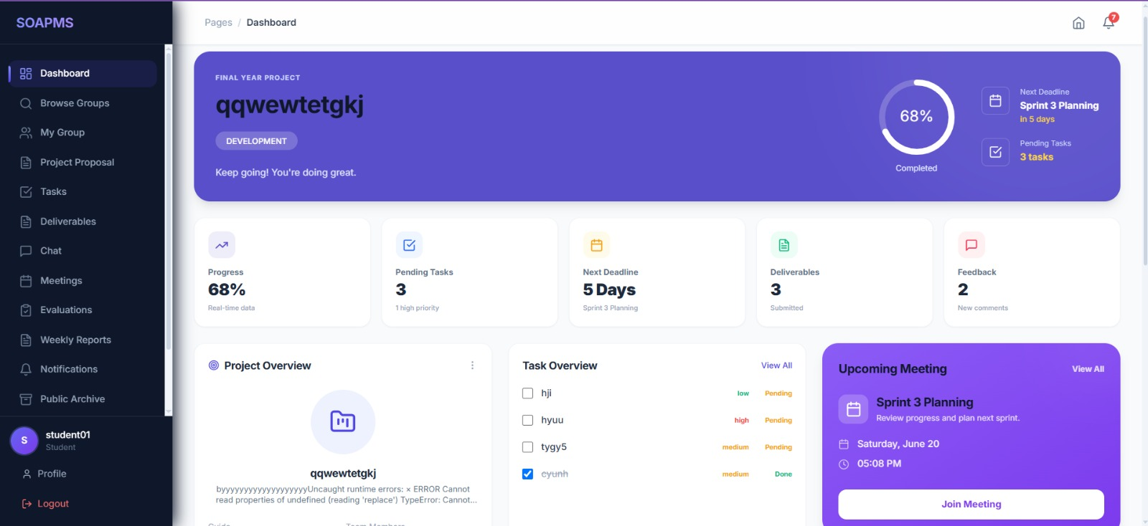
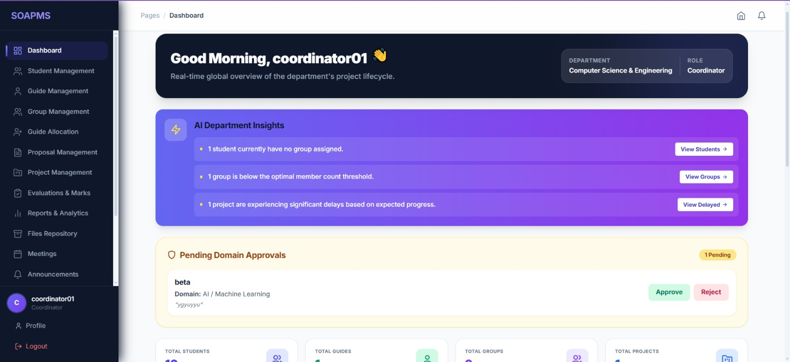
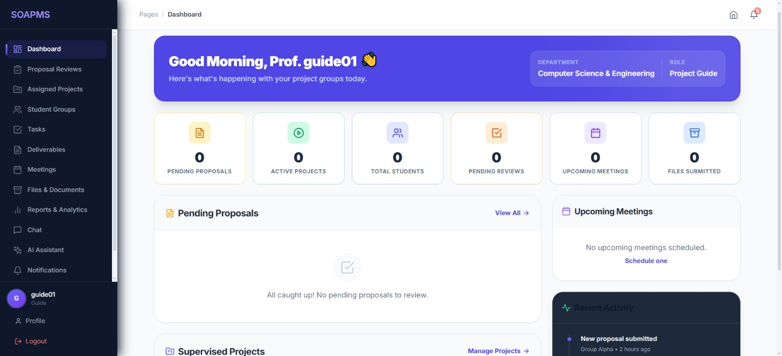
IMPLEMENTATION AND RESULTS
Role-Based Dashboards:
Student & Volunteer Dashboard:
Group Management – Create student groups, invite peers, and manage project member status.
Proposal Submission – Submit final year project proposals directly to the coordinator.
Progress Tracking – View scheduled milestones, submit weekly status, and read supervisor comments.
Digital Dashboard – Receive real-time announcements and download certified evaluation sheets.
Guide & Coordinator Dashboard:
Proposal Appraisals – Coordinators review details and approve/reject project submissions.
Milestone Evaluation – Guides score groups, post feedback reports, and review logs.
Automated Allocation – Assign supervisors to groups using workload and expert matching.
Broadcast Hub – Send instant notices, alerts, and notifications across active student portals.

Slide 17
Advantages and Disadvantages
Advantages
Centralized project management with role-based access.
Automated guide allocation and project tracking.
AI-based topic similarity checking and plagiarism detection
Improved transparency and reduced administrative workload.
Disadvantages
Requires stable internet connectivity.
Initial setup and maintenance require technical expertise.
AI-generated suggestions may require manual verification.

Slide 18
Application
Higher Education Institutions: Project submission, tracking, and evaluation.
Research & Development Labs: Collaborative research project management.
Corporate Training & Internships: Monitoring trainee projects and progress.
Online Learning Platforms: Virtual project collaboration and assessments.
Administrative Use: Analytics, reporting, and deadline monitoring.

Slide 19
Conclusion
Developed a centralized platform for academic project management.
Automated guide allocation, project tracking, and evaluation processes.
Enhanced transparency through real-time notifications and collaboration.
Improved project originality using AI-based topic similarity checking.
Designed a scalable and secure system for future enhancements.

Slide 20
References
[1] J. Wang, “A Web-based Innovation and Entrepreneurship Project Management System Design for College Students,” 2024 International Conference on Distributed Computing and Electrical Circuits and Electronics (ICDCECE), IEEE, 2024, DOI: 10.1109/ICDSCNC62492.2024.10939838
[2] R. Qi, Y. Qi, and H. Tang, “Analysis of Multi-Objective Integrated Management System of Engineering Project Based on Ant Colony Algorithm,” 2023 International Conference on Distributed Systems, Computer Networks and Cybersecurity (ICDSCNC), 2023, DOI: 10.1109/ICDCECE57866.2023.10150990.
[3] V. Arumugam, M. Shankar, and A. B. Aslam, “Academic Project Information Management System,” 2021 IEEE International Conference on Computer Communication and Informatics (ICCCI), Coimbatore, India, 2021, DOI: 10.1109/ICCCI50826.2021.9402561.
[4] S. I. Ismail, S. N. Sulaiman, and N. N. Ismail, “Online Project Evaluation and Supervision System (oPENs),” 2017 IEEE 9th International Conference on Engineering Education (ICEED), Kanazawa, Japan, 2017, pp. 99–104, DOI: 10.1109/ICEED.2017.8251185.

Slide 21
References
[5] Feng Wang, Ji Wang, Hao Cai, Gang Yang,“Research and Application of Visual Engineering Project Management and Control System Based on Multimodal Information,”2024 16th IEEE International Conference on Computational Intelligence and Communication Networks (CICN), DOI: 10.1109/CICN.2024.188,IEEE, pp. 1136–1140, 2024.
[6] Liubava Chernova, Serhii Chernov, Iryna Zhuravel, Lyudmila Chernova, Anatoliy Zubarev, Kateryna Kolesnikova,“Structural Analysis in the Methodology of Building an IT Project Model,”2024 IEEE 4th International Conference on Smart Information Systems and Technologies (SIST),Astana, Kazakhstan, May 15–17, 024, DOI:10.1109/SIST61555.2024.10629514.
[7]A. A. Santoso, M. Y. S. A. Winata, M. L. A. Cahyadi, and I. R. Murmanto, “Approval System Development in Information System for Project Management in a Retail Company,” in Proc. 2024 International Conference on Intelligent Cybernetics Technology & Applications (ICICyTA), pp. 401–406, IEEE, 2024. DOI: 10.1109/ICICYTA64807.2024.10912934.
[8] A. Tripathi and K. T. V. Reddy, “Development of an Intelligent System for Predictive Analysis of Student Academic Performance using Machine Learning Techniques,” in Proc. 2025 International Conference on Inventive Computation Technologies (ICICT), IEEE, pp. 1110–1117, DOI: 10.1109/ICICT64420.2025.11005033, ISBN: 979-8-3315-1224-8.

Slide 22
References
[9] R. Reshmi, et al., “Enhancing Academic Project Management with Project Allocation and Management System (PAMS),” in 2025 International Conference on Computing and Intelligent Systems, 2025.
[10] P. Yu, “Design of a University Innovation and Entrepreneurship Project Management System Based on Web and Collaborative Filtering Algorithms,” in 2024 IEEE 2nd International Conference on Image Processing and Computer Applications (ICIPCA), Shenyang, China, June 28–30, 2024, DOI: 10.1109/ICIPCA61593.2024.10709251.
[11] N. I. S. I. Jailani, A. F. M. Ali, and S. Ngah, “Final Year Project Allocation System Techniques: A Systematic Literature Review,” in 2022 IEEE 12th Symposium on Computer Applications and Industrial Electronics (ISCAIE), 2022.
[12] M. R. Davahli, “The Last State of Artificial Intelligence in Project Management,” arXiv preprint arXiv:2012.12262, 2020.
[13] H. K. Dam, T. Tran, J. Grundy, A. Ghose, and Y. Kamei, “Towards Effective AI-Powered Agile Project Management,” arXiv preprint arXiv:1812.10578, 2018.

Slide 23
Thank You
NBN Sinhgad School of Engineering
2025-2026 Sem VIII
Group 20

